Slide 1
Electronic Inspection Lodgement (EIL) Showcase
CED ROM – Network & Asset 27Oct 2023

Slide 2
Agenda
1 | Project overview
 | Business problem definition
 | Technical solution summary
 | Business outcomes
 | Technology stack
2 | Interactive showcase
 | Key solution features
 | Major wins
3 | Q&A

Slide 3
Project overview
01

Slide 4
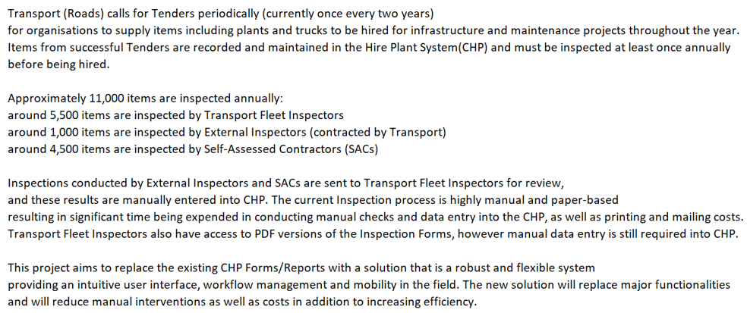
Business Problem Definition

Slide 5
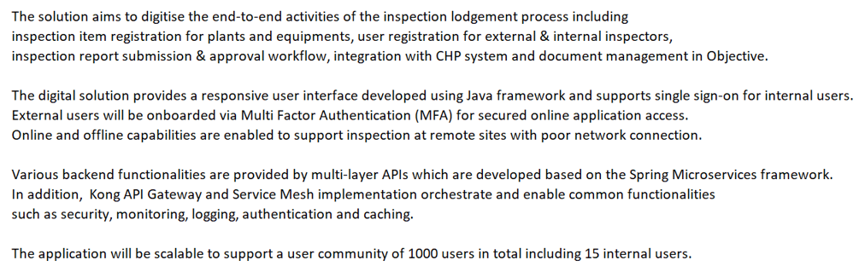
Technical Solution Summary

Slide 6
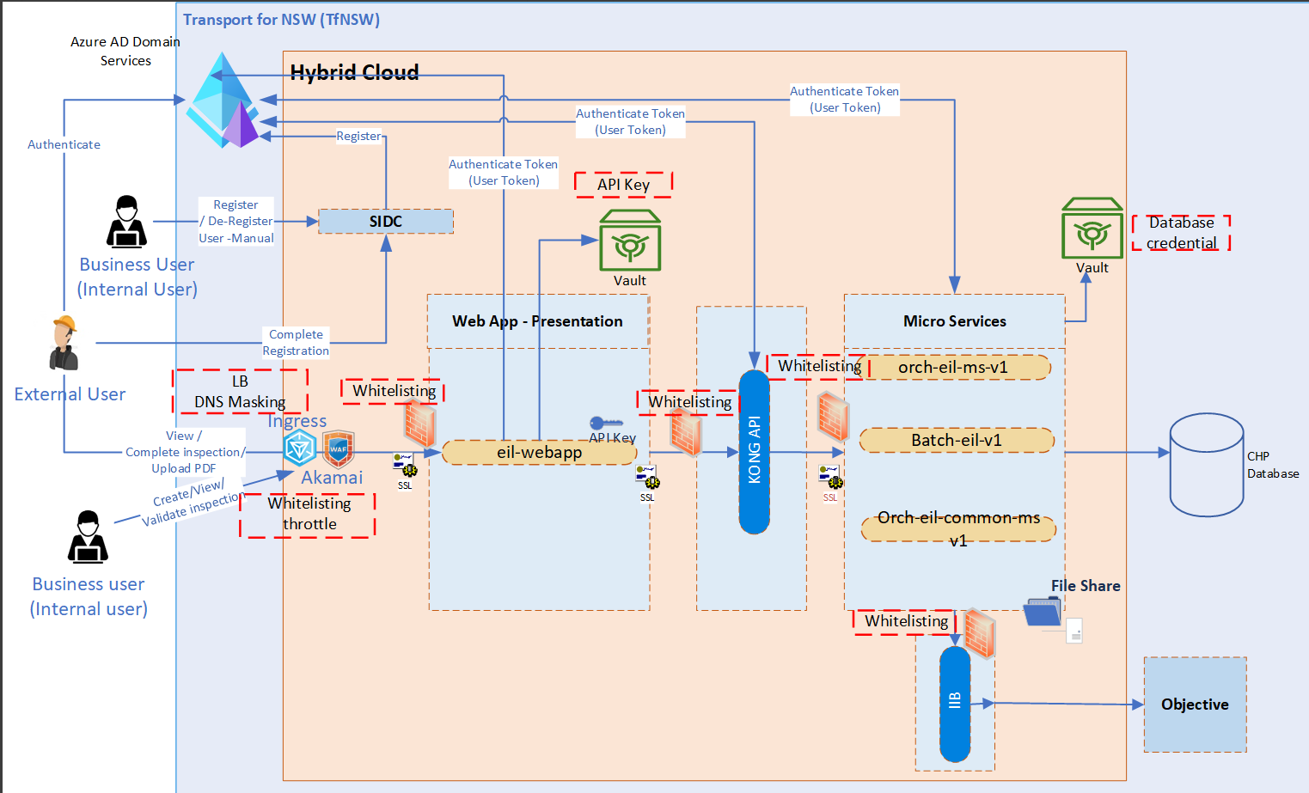
Technical Solution Design

Slide 7
Technology Stack
Java Microservices
Angular 15
Progressive web Application
Oracle Database
Azure AD integration with MFA
KONG onboarding (UI to API)
Akamai configuration for external users (EIL domain)
Objective API integration REST API
Offline capability
Responsive UI for different devices specifically for iPad

Slide 8
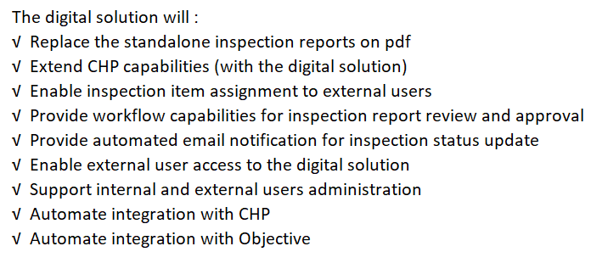
Business Outcomes

Slide 9






EIL System Flow
CHP System
Objective
System Admin
Plant
Contractor/Items
Submits the inspection-
Creates pdf and send it to the plant contractor
Submits the inspection – Sends to objective system
Fleet Inspector
Sends the inspection back for rework
Performs system admin activities
EEH Team Member
Assign fleet inspectors to plant contractors
Assign external inspectors to plant items
Submits the inspection for review
External Inspector

Slide 10
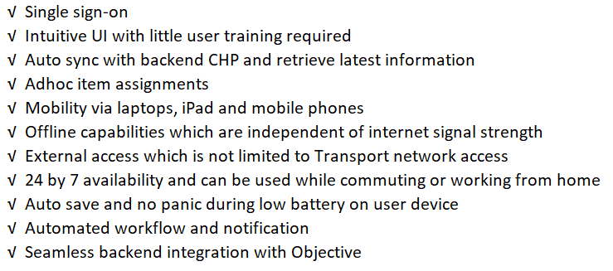
Key Solution Features

Slide 11
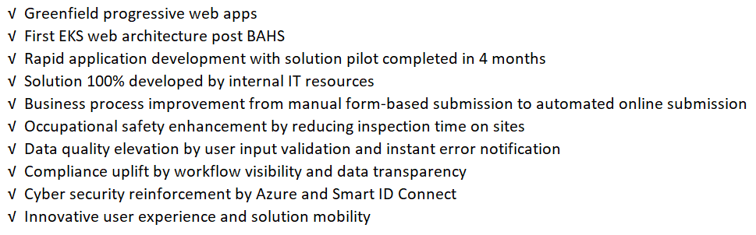
Major Wins

Slide 12
Interactive showcase
02

Slide 13
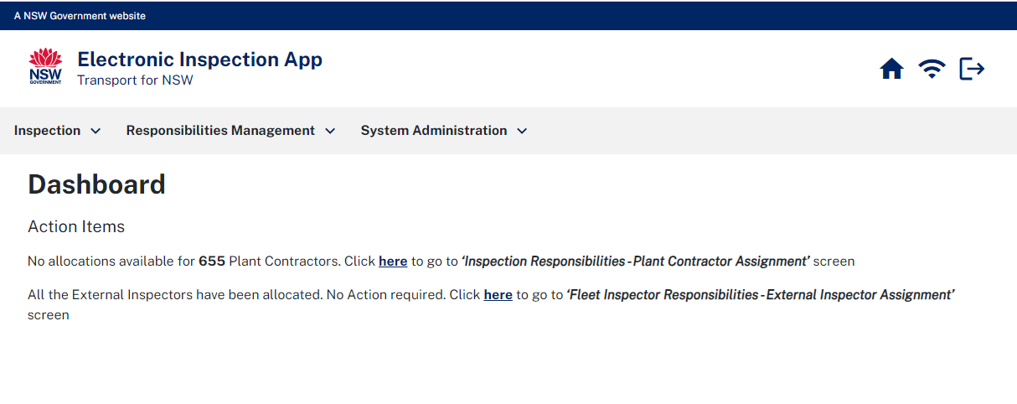
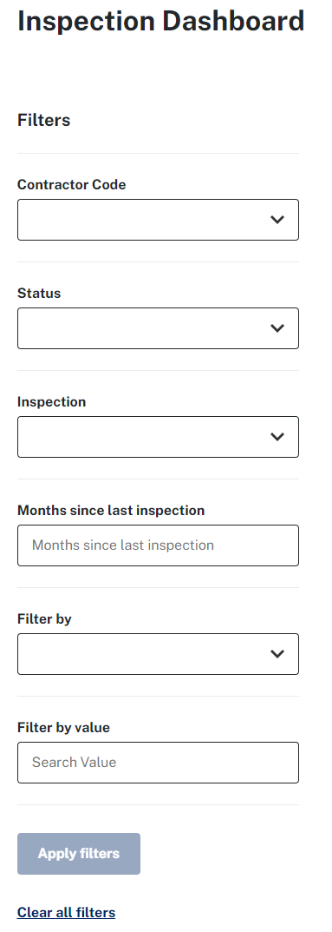
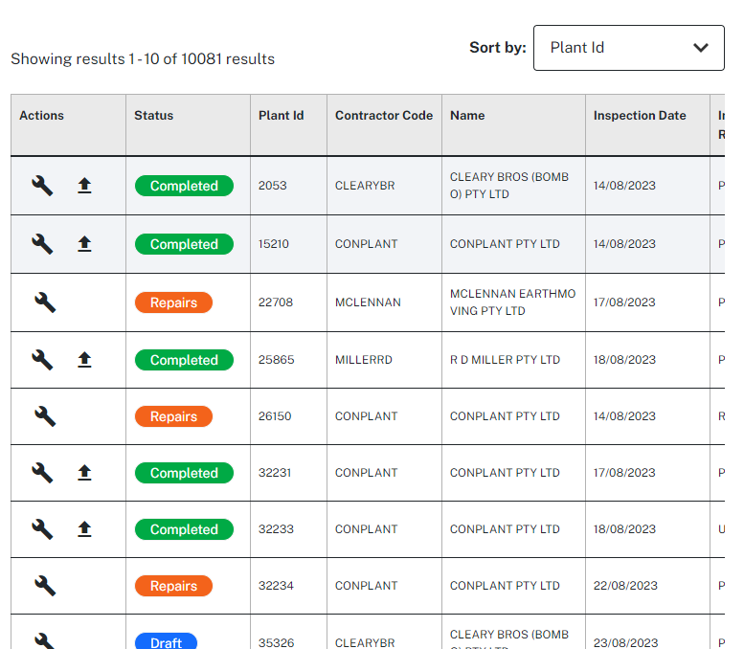
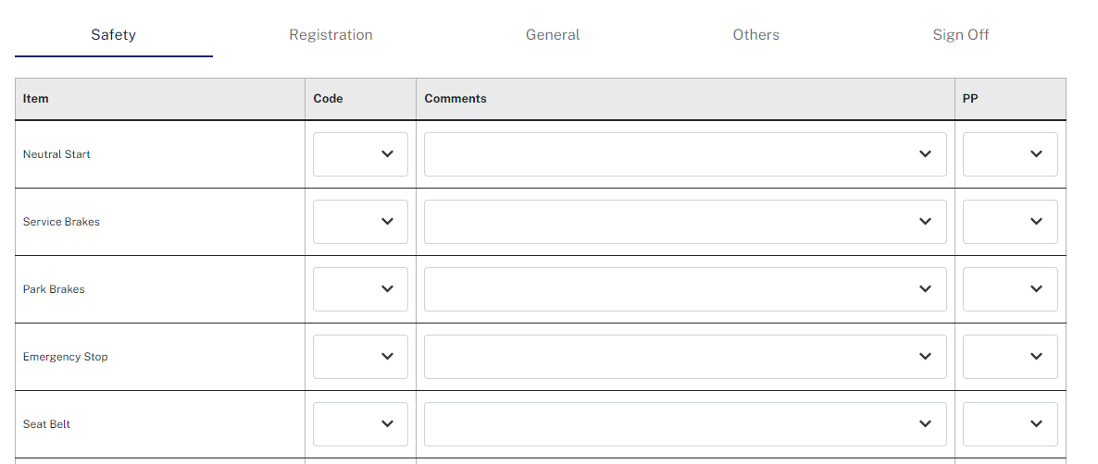
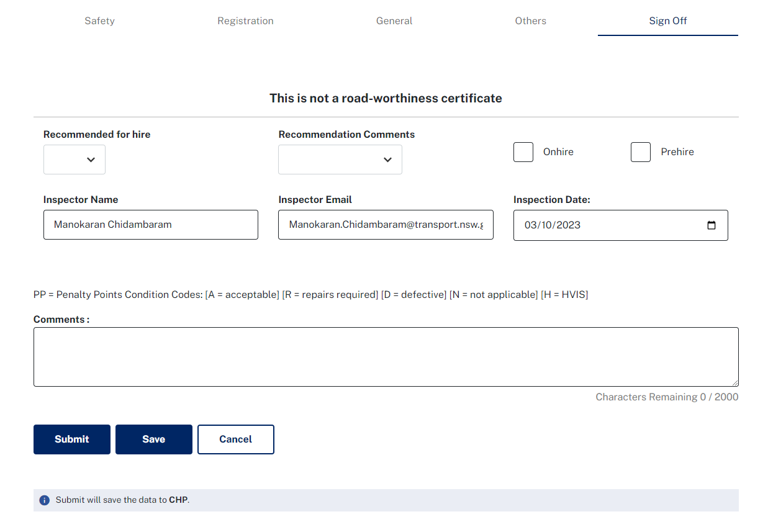
EIL UI & Layout

Slide 14
Q & A
03

Slide 15
Thank You

